Slide 1

Computer Vision Lecture 2: Imaging Fundamentals and Image Representation
School of Software, SJTU

Slide 2
Outline
Imaging Fundamentals
Image Representation

Slide 3
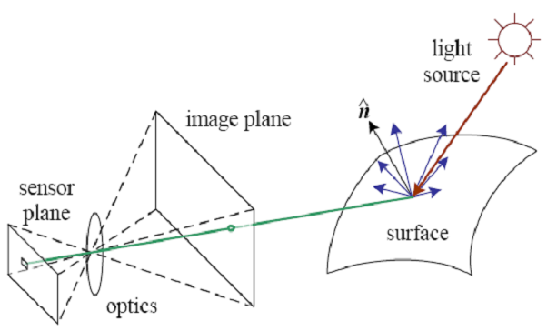
Imaging Process
Light reaches surfaces in 3D.
Surfaces reflect.
Sensor element receives light energy.
Intensity is important.
Angles are important.
Material is important.
A simplified model of photometric image formation. Light is emitted by one or more light sources, and is then reflected from an object's surface. A portion of this light is directed towards the camera. This simplified model ignores multiple reflections, which often occur in real-world scenes.

Slide 4
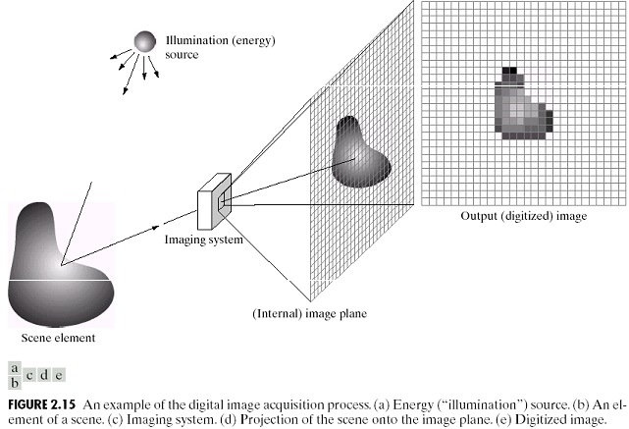
Image Acquisition
Adapted from Gonzales and Woods

Slide 5
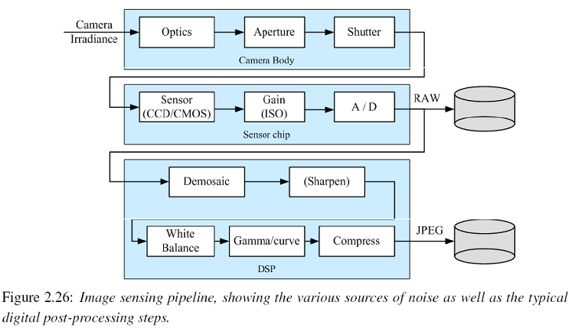
Image Acquisition
Adapted from Rick Szeliski

Slide 6
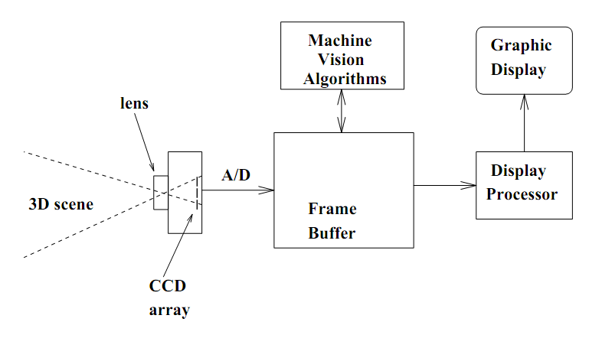
Imaging Devices
CCD cameras: central role of the frame buffer in image processing

Slide 7
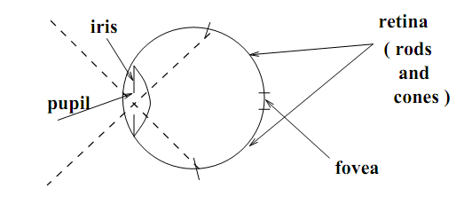
The Human Eyes
Crude sketch of the human eye as camera

Slide 8
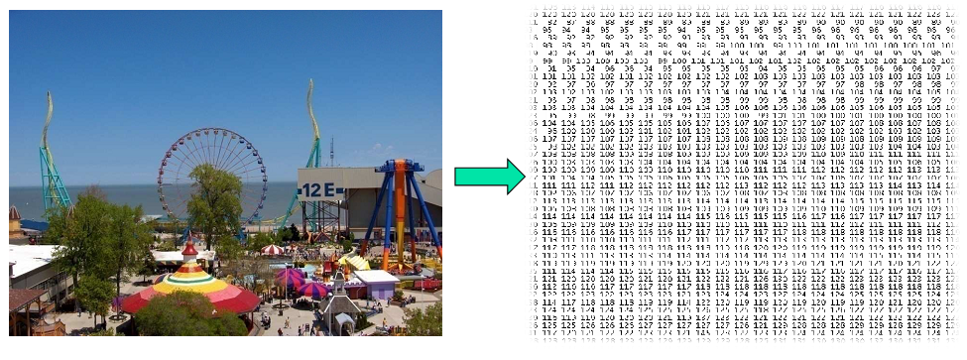
What the Computer Gets from an Image

Slide 9
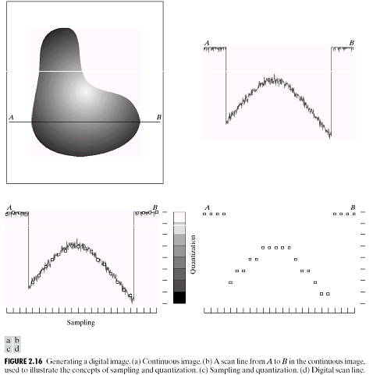
Sampling and Quantization
Adapted from Gonzales and Woods

Slide 10
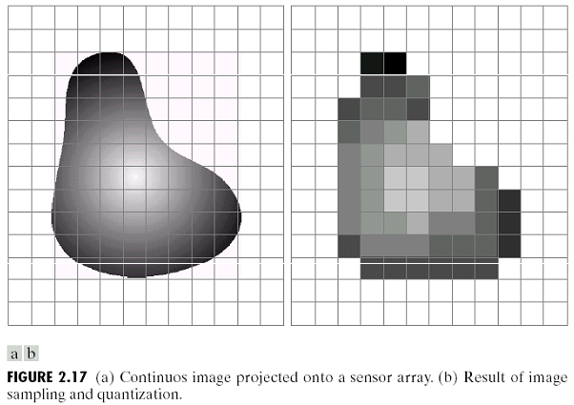
Sampling and Quantization
Adapted from Gonzales and Woods

Slide 11
Quantization
•
f

Slide 12
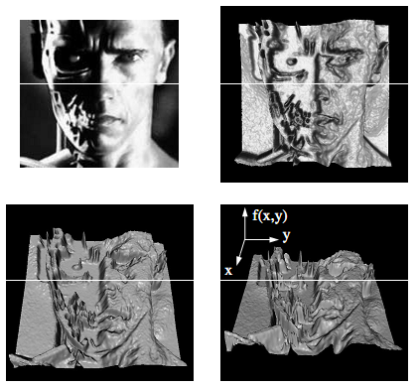
Image Representation
Image can be represented by 2D functions of the form f(x,y)
The physical meaning of value of f at spatial coordinates (x,y) is determined by the source of the image.
Adapted from Shapiro and Stockman

Slide 13
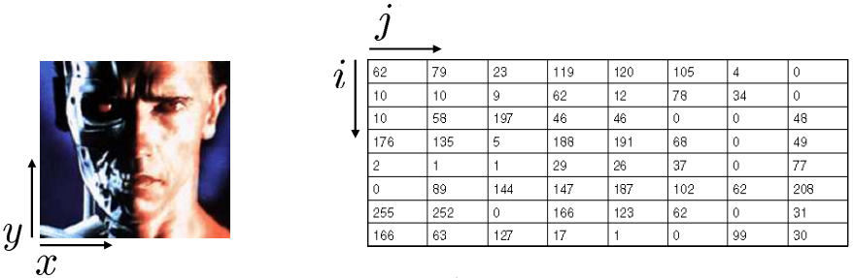
Image Representation
In a digital image, both the coordinates and the image value become discrete quantities.
Image can now be represented as 2D arrays (matrices) of integer values: I[i,j] (or I[r,c]).
The term gray level is used to describe monochromatic intensity.

Slide 14

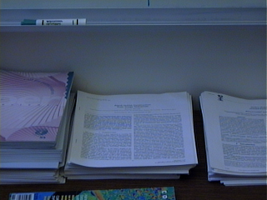
Vision: a split personality
Answer # 1: pixel of brightness 243 at position (124,54)
…and depth .7 meters
Answer #2: looks like bottom edge of whiteboard showing at the top of the image
depth map

Slide 15
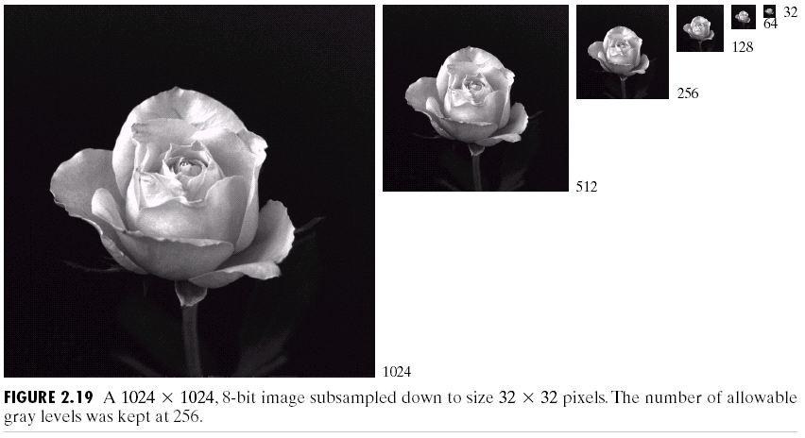
Image quality and sampling

Slide 16
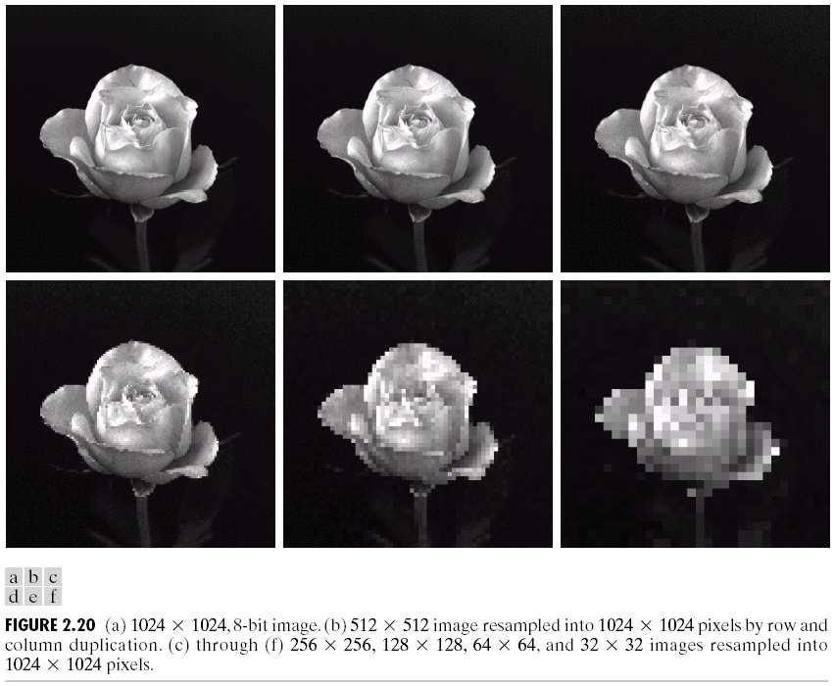
Image quality and sampling
1024×1024 512×512
256×256
128×128
64×64
32×32

Slide 17
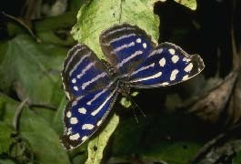


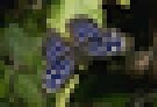
Image quality and quantization
265x180
133x90
66x45
33x22

Slide 18
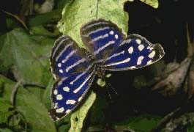
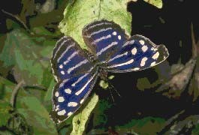
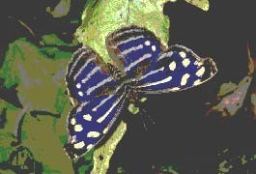
Image quality and quantization
256灰度级
16灰度级
8灰度级
4灰度级

Slide 19
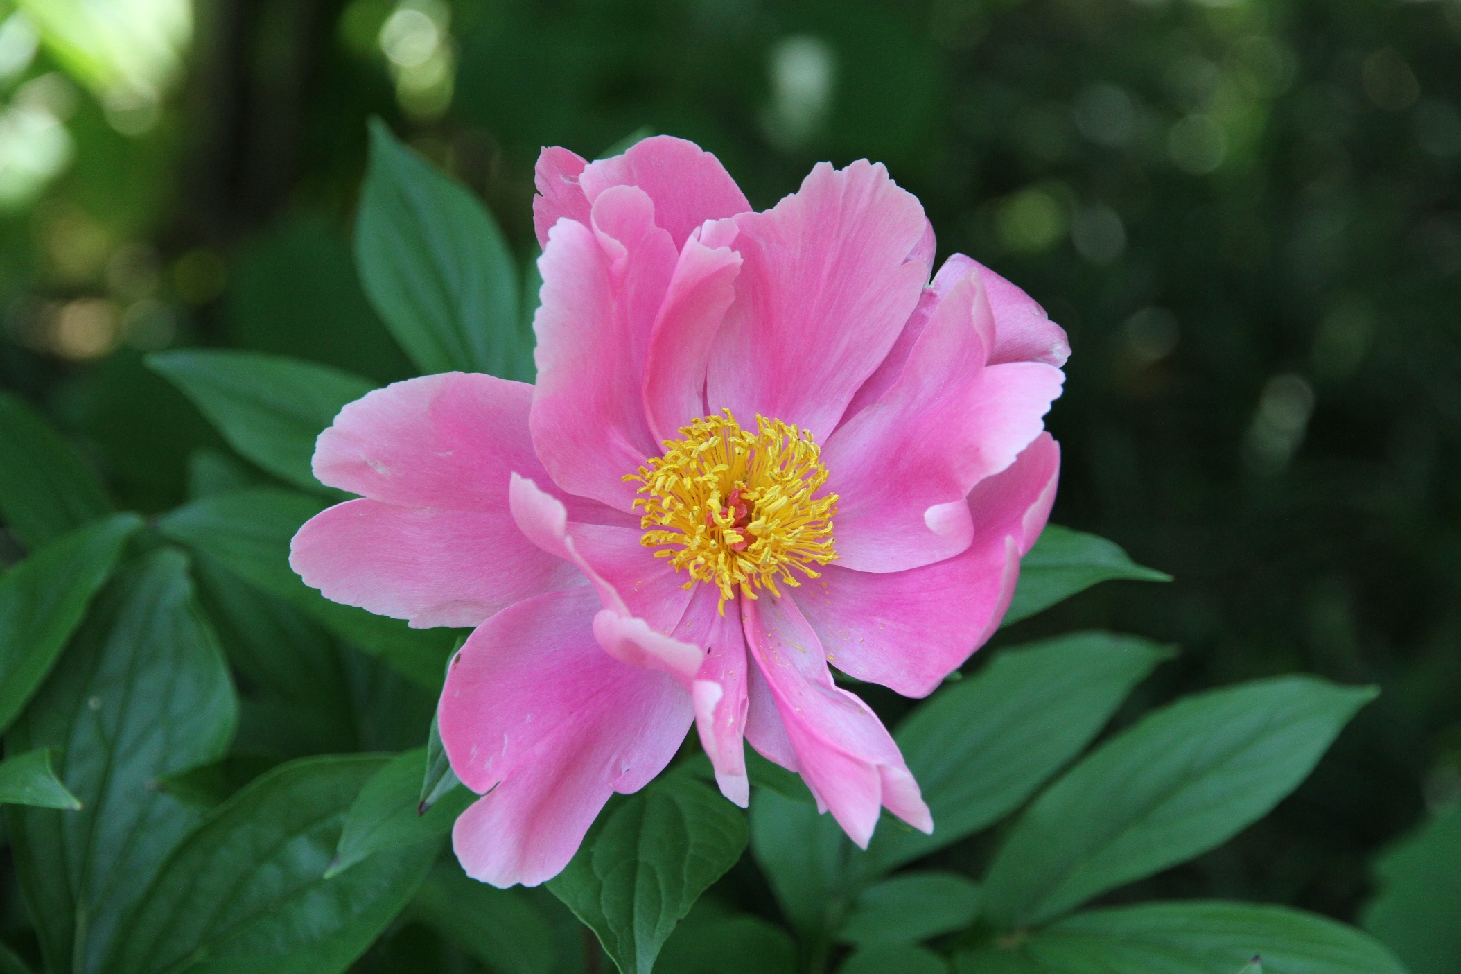

Slide 20



Image quality：Level
256
64
16

Slide 21
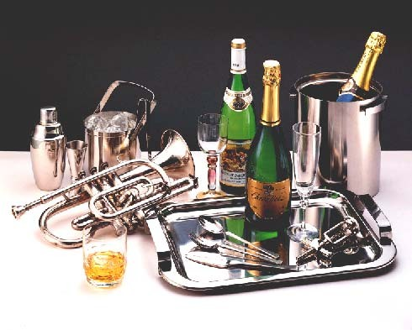
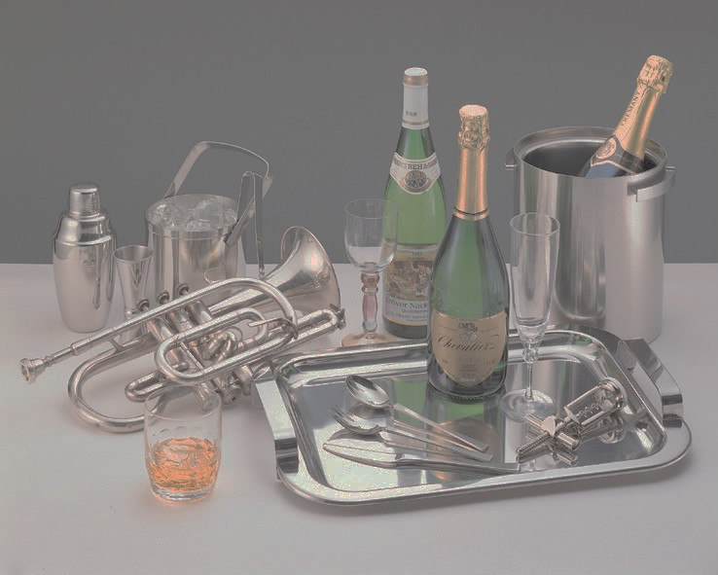
Image quality：Contrast
• Contrast = Highest / lowest

Slide 22
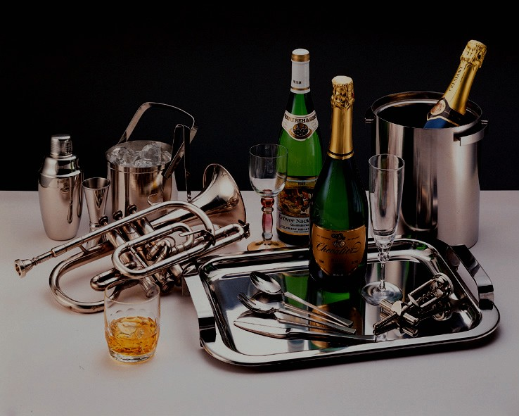
Image quality：Intensity

Slide 23
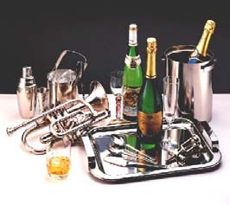
Image quality：Size

Slide 24
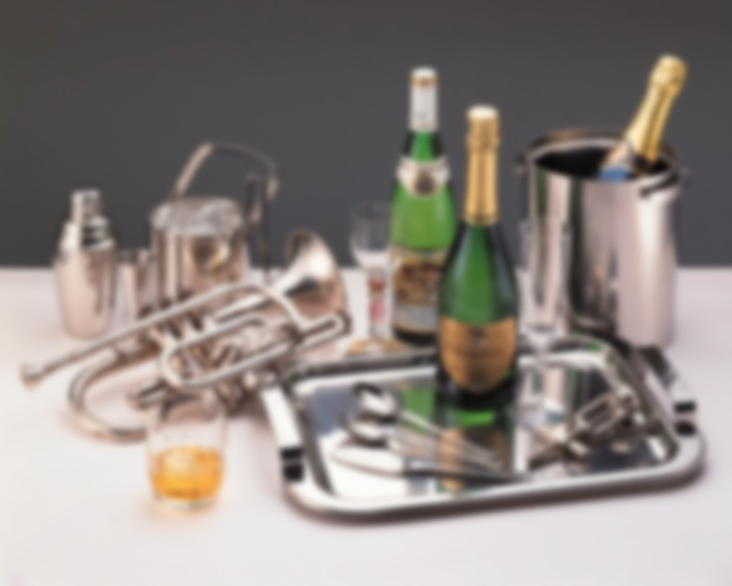
Image quality：Levels

Slide 25
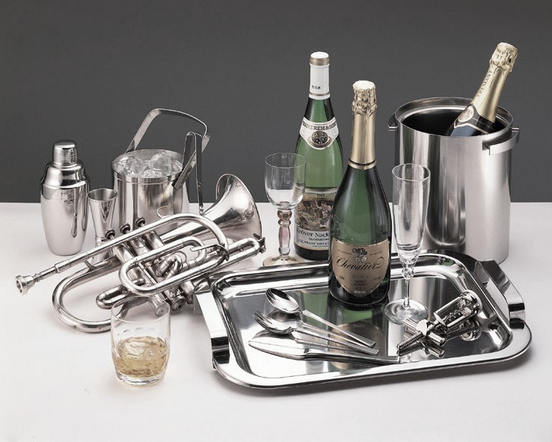
Image quality：Saturation

Slide 26
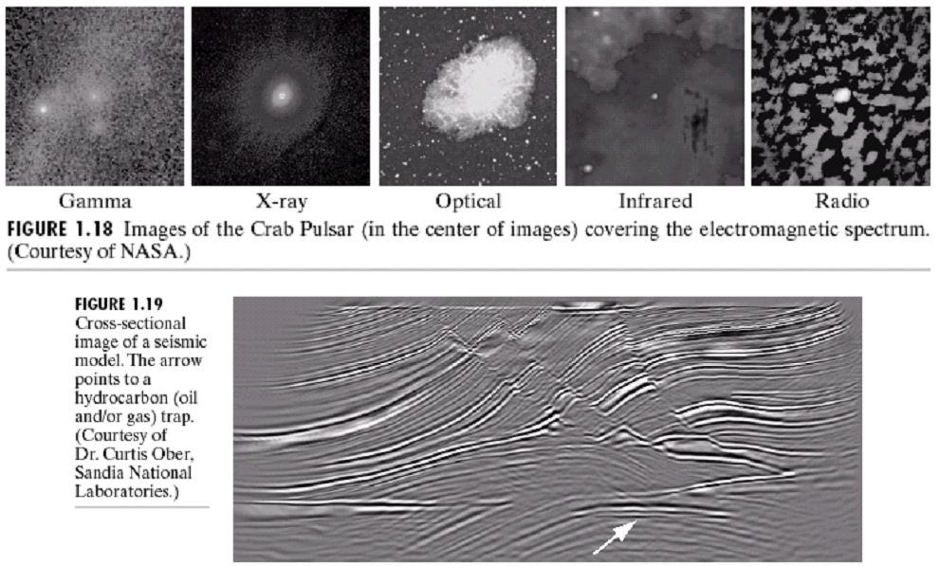
Other Types of Sensors

Slide 27
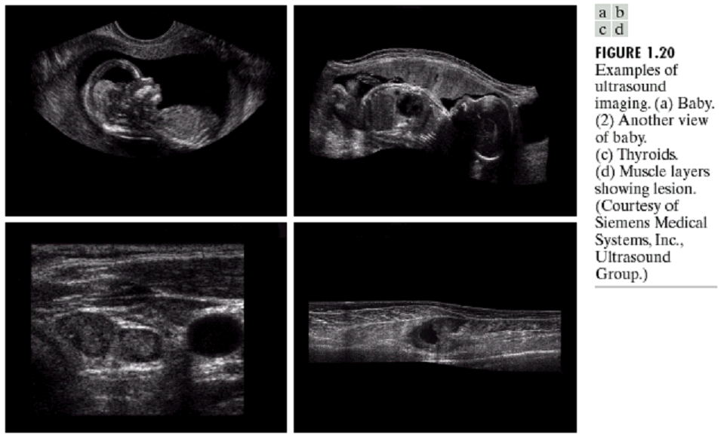
Other Types of Sensors

Slide 28
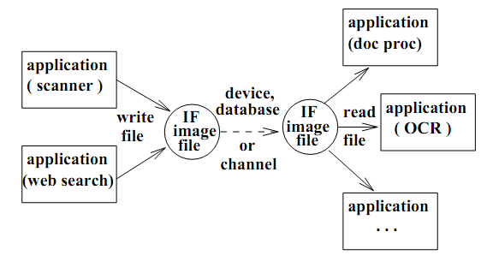
Digital Image Formats
Many devices or application programs create, consume, or convert image data. Standard format image files (IFs) are needed to do this productively for a family of devices and programs.

Slide 29
Digital Image Formats
Three Key Factors
Image file header
Image Data
Data Compression

Slide 30
Digital Image Formats
Commonly used formats:
run-coded binary images
PGM: Portable Grey Map
GIF image file format
TIFF image file format
JPEG format for still photos
PostScript
MPEG format for videos

Slide 31
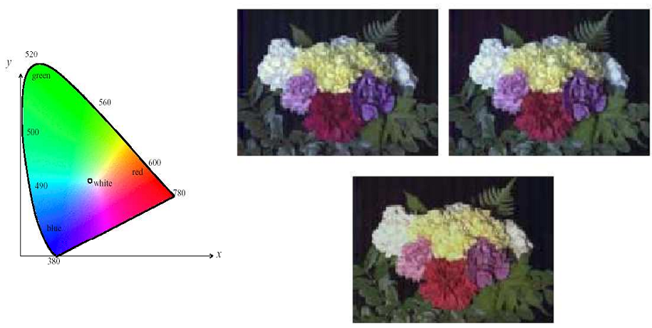
Information We Can Use
Color

Slide 32
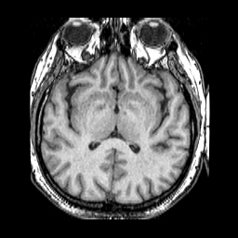
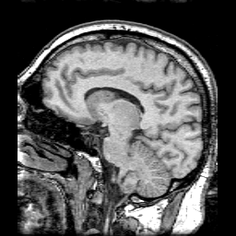
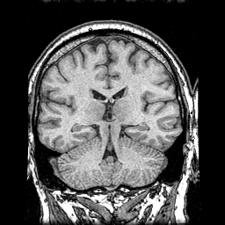
Information We Can Use
Pixel Intensity

Slide 33
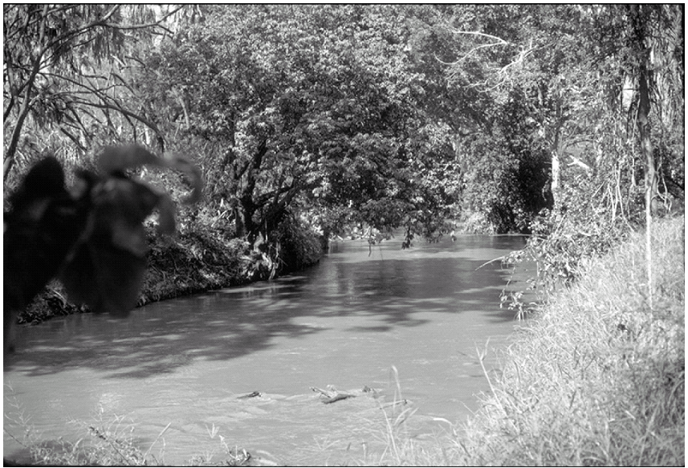
Information We Can Use
Texture

Slide 34
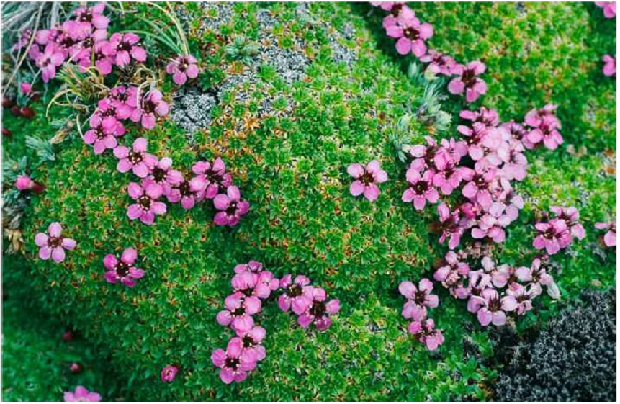
Information We Can Use
Color, Texture and Proximity

Slide 35
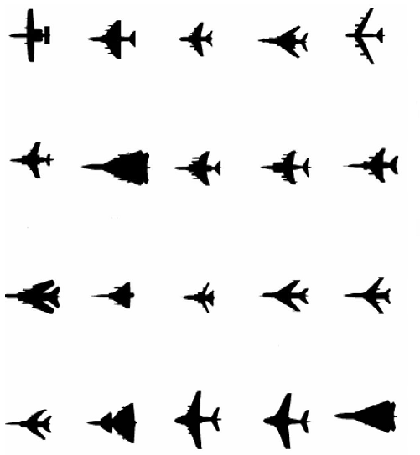
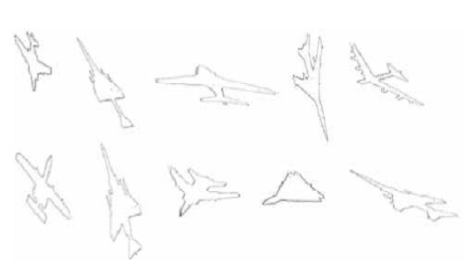
Information We Can Use
Shape

Slide 36
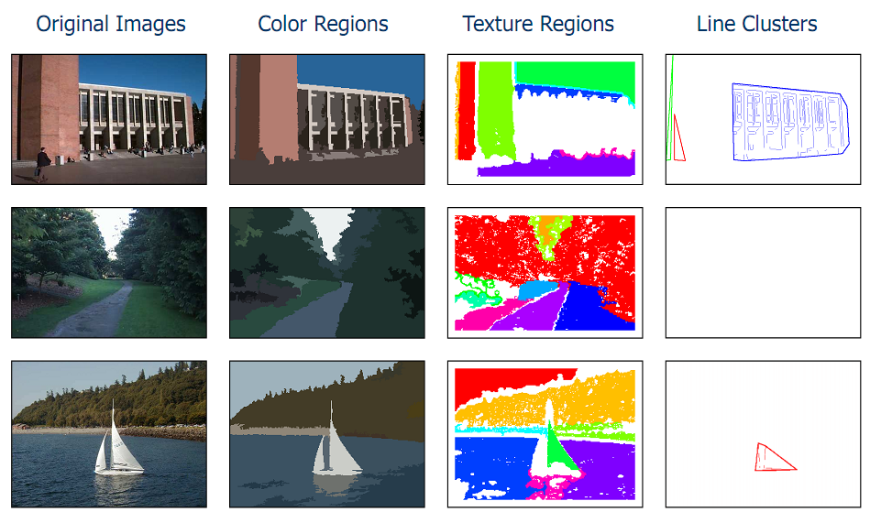
Segmentation by Information

Slide 37
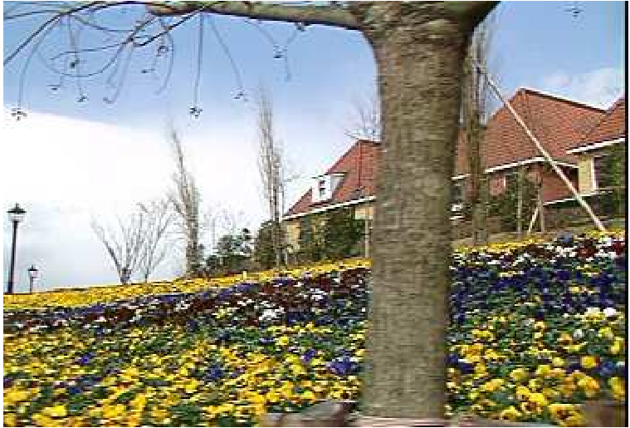
Information We Can Use
Motion

Slide 38
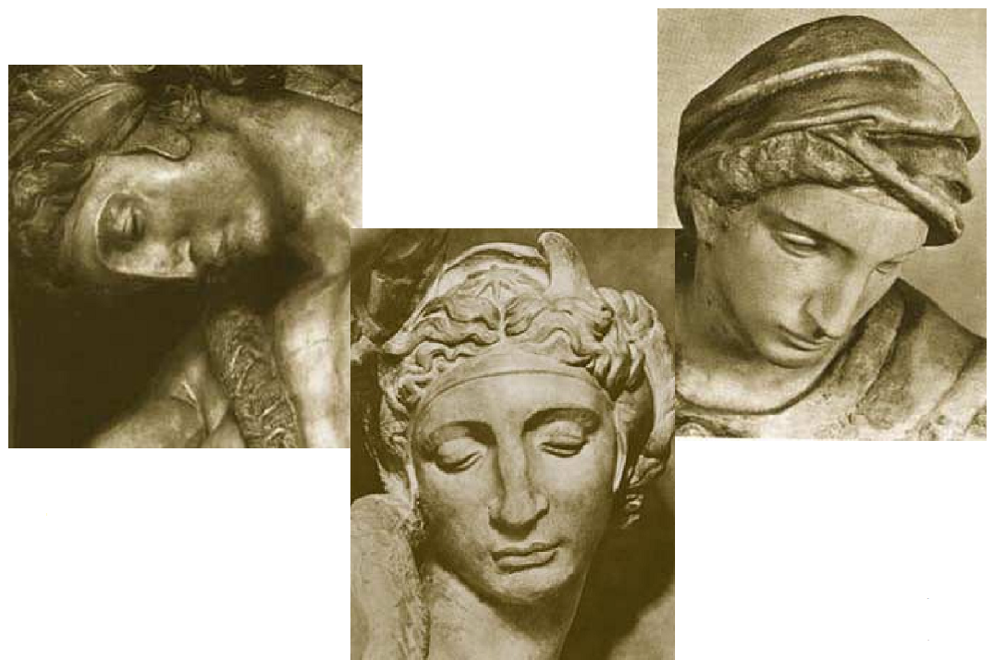
Challenge #1: View Point Variation
Michelangelo 1475-1564

Slide 39
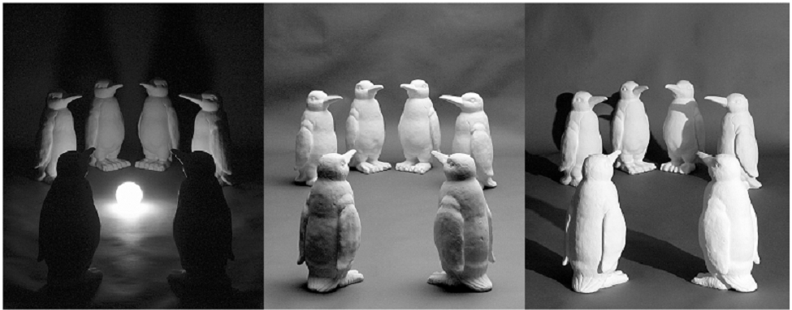
Challenge #2: Illumination

Slide 40
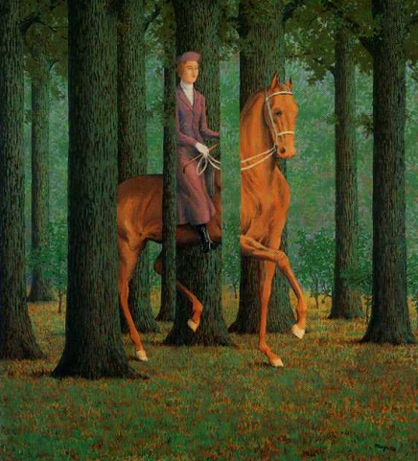
Challenge #3: Occlusion
Magritte, 1957

Slide 41
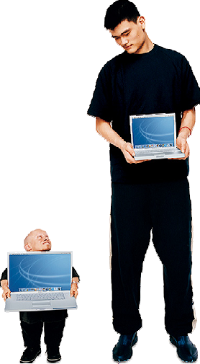
Challenge #4: Scale

Slide 42
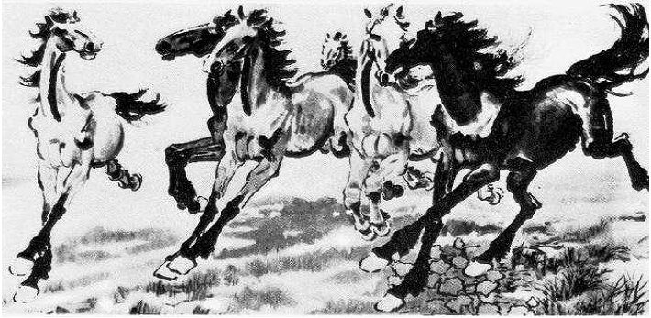
Challenge #5: Deformation
Xu, Beihong 1943

Slide 43
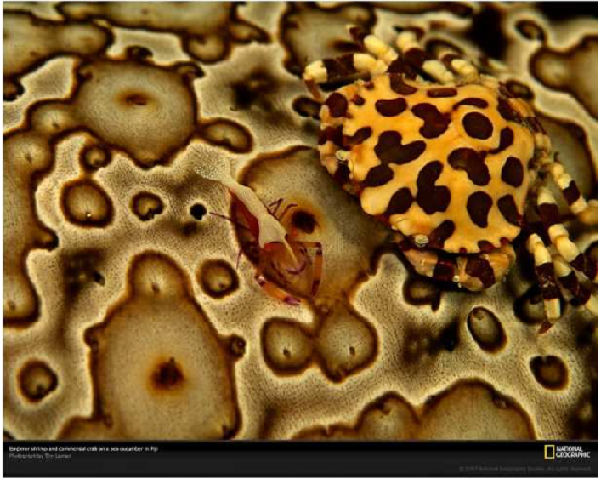
Challenge #6: Background Clutter

Slide 44
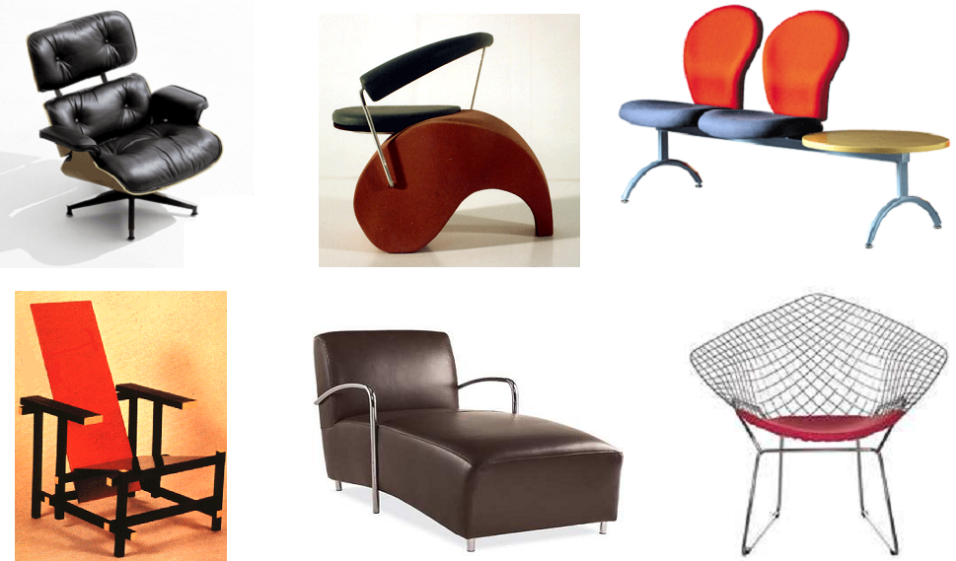
Challenge #7: Intra-Class Variation

Slide 45
Thank you for your attention and attendance.

